Slide 1
Machine Learning

Slide 2
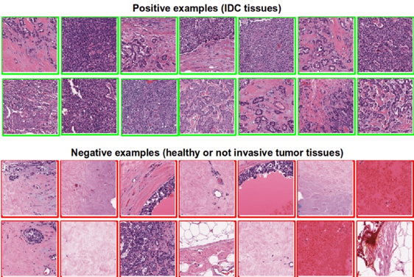
Is this Cancer?

Slide 3
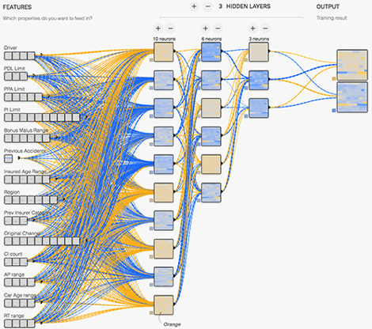
How Risky is this driver?

Slide 4
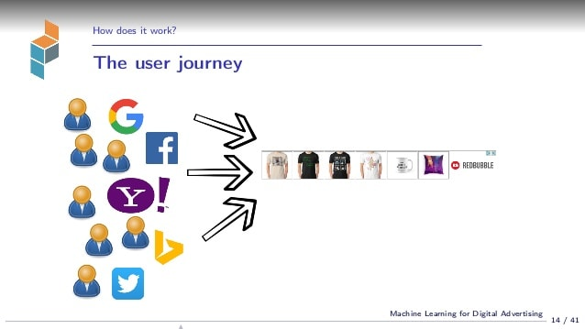
Who’s Going to Buy My Product?

Slide 5
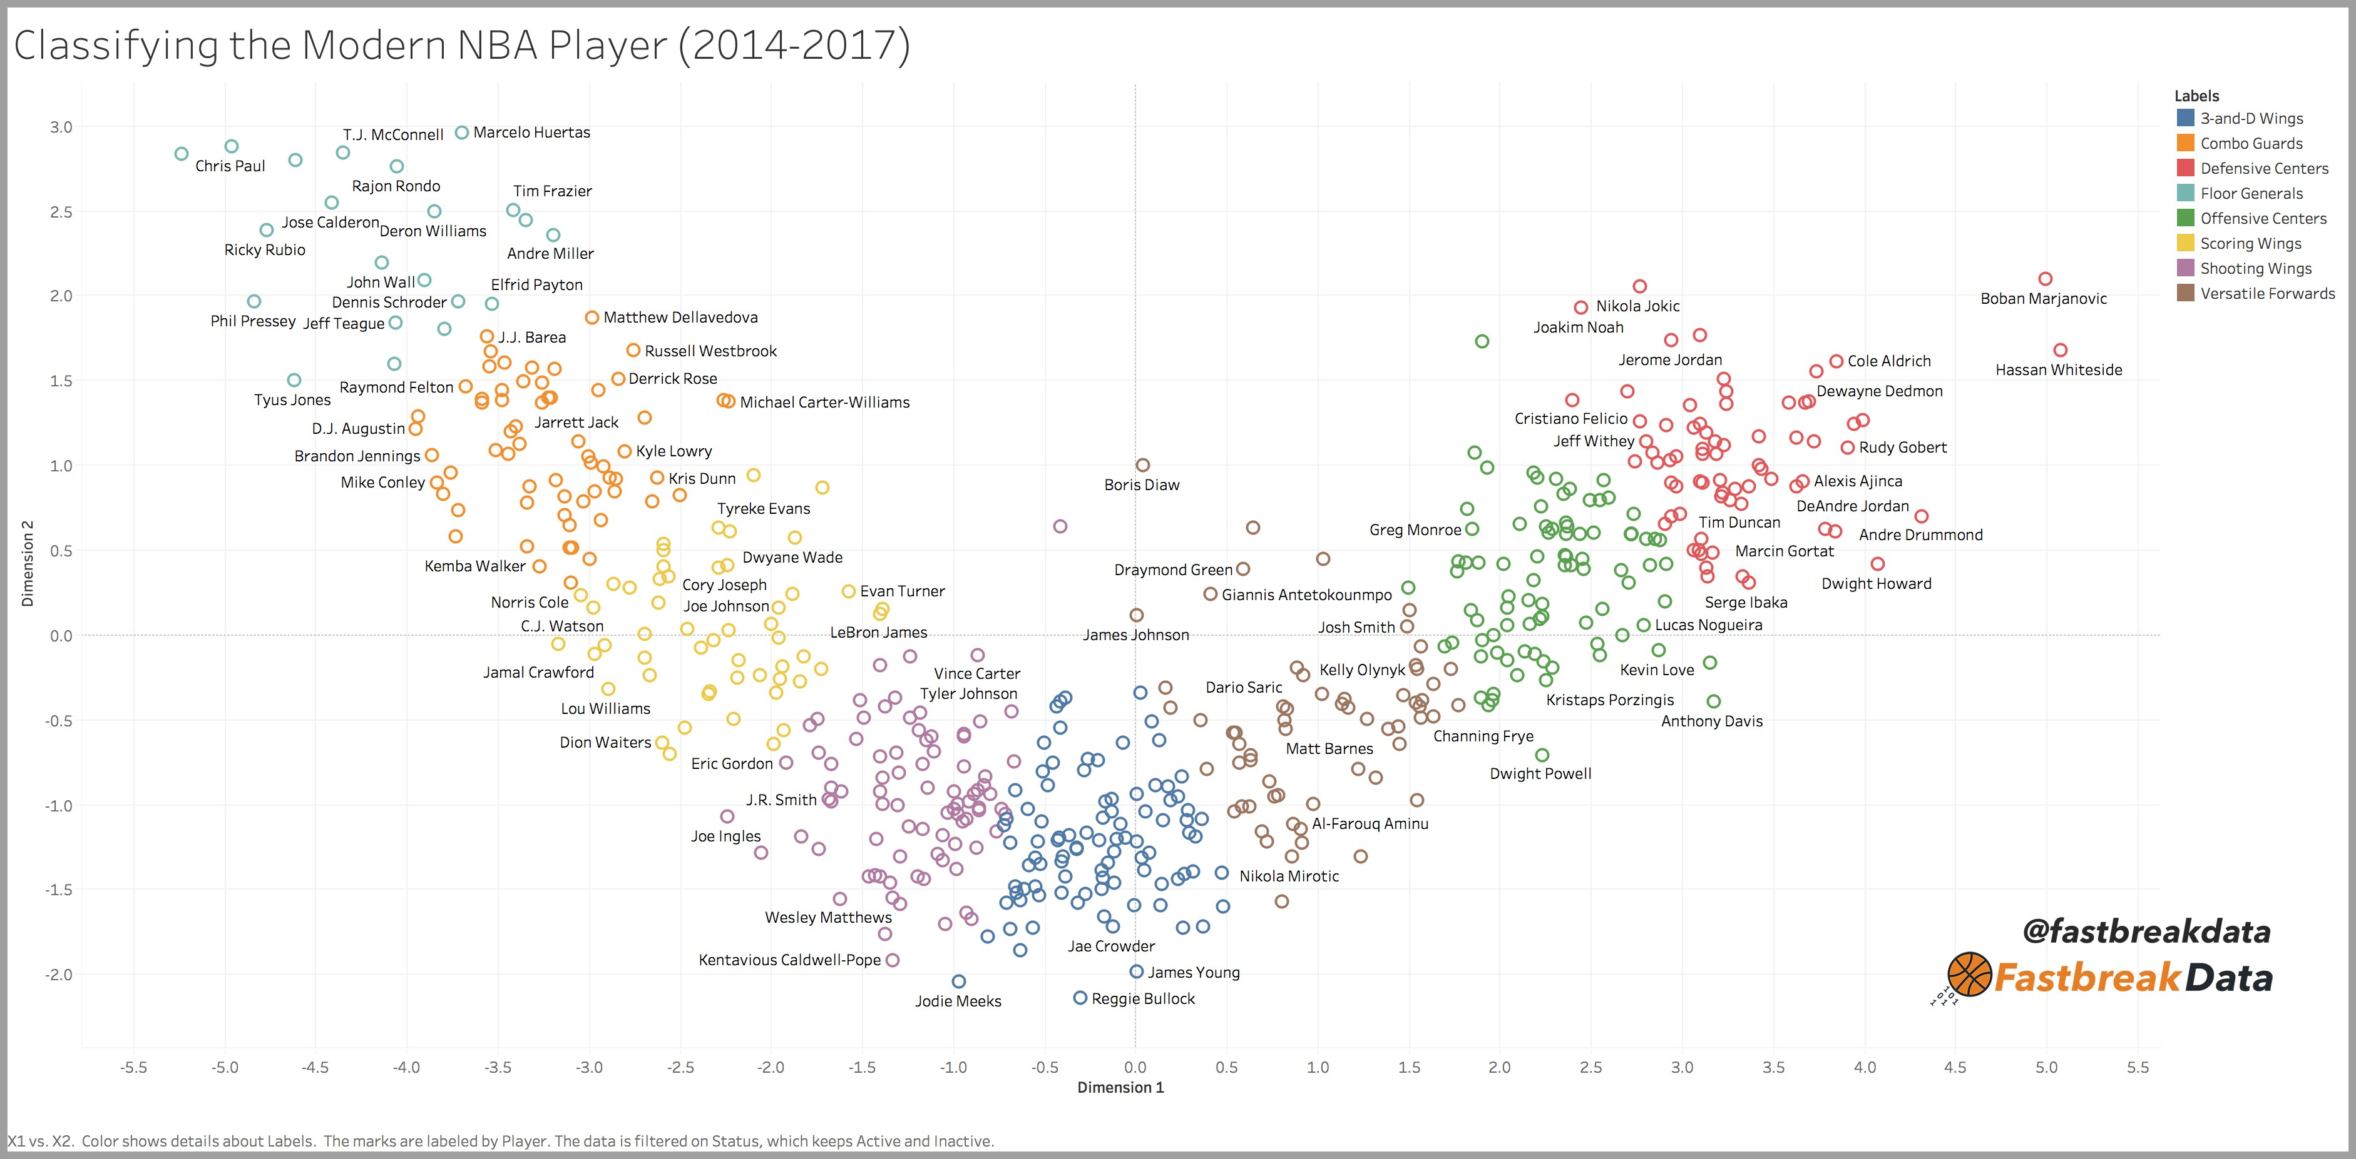
Is this Player Going to Excel in the NBA?

Slide 6
Machine Learning
Computerized information systems allow us to capture massive amounts of data.
Machine learning is using computers to detect patterns and use those patterns to make predictions.

Slide 7
What’s the Key?
We don’t tell the computer how to make predictions.
We give the computer old examples, it figures out how to make predictions itself.

Slide 8
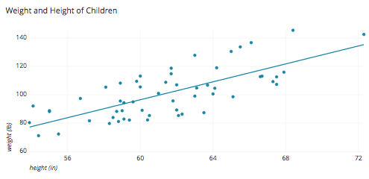
You’ve Done this Already….

Slide 9
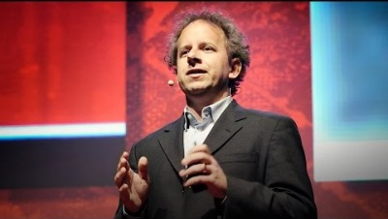

Slide 10
Old Concepts, New Applications
That idea isn’t new (how do you predict if a restaurant will be good? If a job is worth applying for? If someone will date you?)
The scale, breadth, speed, and accuracy are new.

Slide 11
What’s this Deep Learning Bit?
Deep Learning uses neural networks – one type of algorithm of machine learning.
The DL algorithm can be replaced with linear regression, trees, or any other algorithm and the concepts are the same.

Slide 12
The Process is Simple
1 – Collect data on what we care about.
2 – ‘Clean’ that data up.
3 – Give the data to the algorithm to learn.
4 – Let the model generated from the algorithm make new predictions.

Slide 13
What are We going to do…
Build several types of models using different algorithms.
Apply these models in different types of predictions…

Slide 14
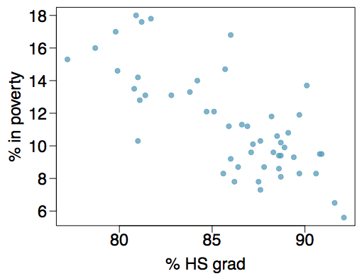
Review – Regression and Gradient Descent

